Slide 1
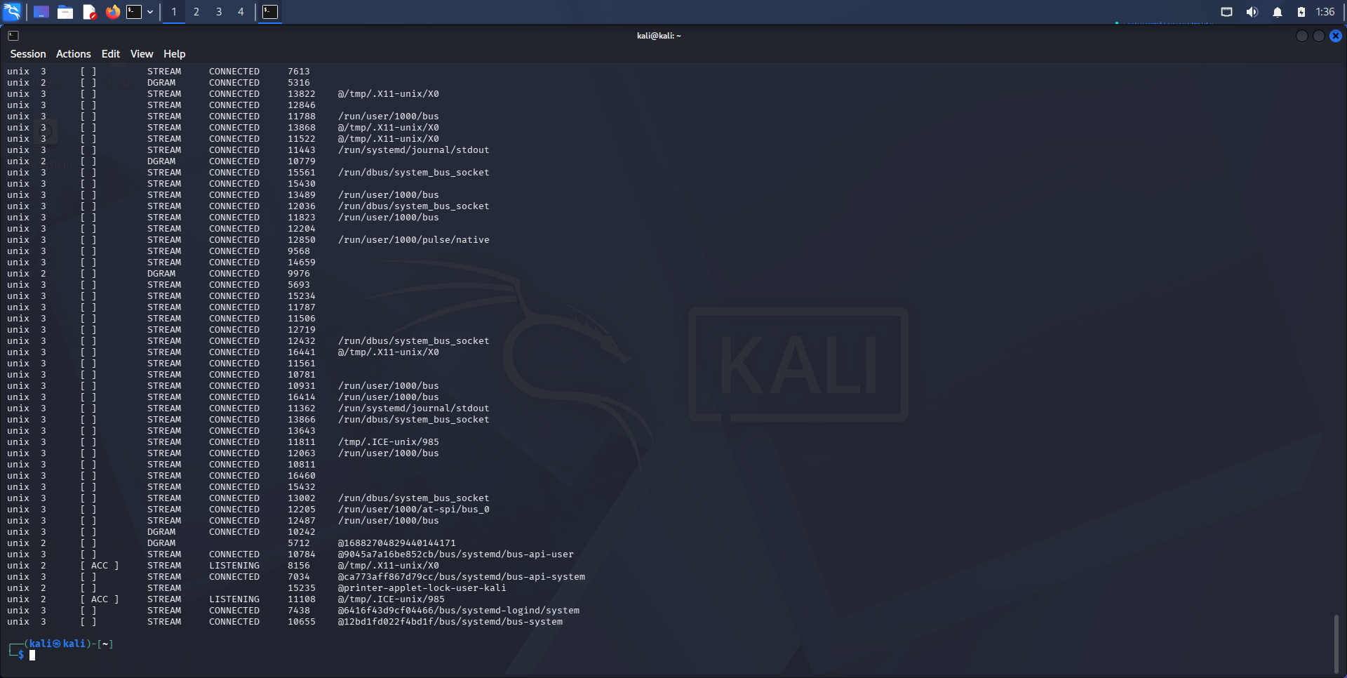
Netstat-an showing all connections

Slide 2
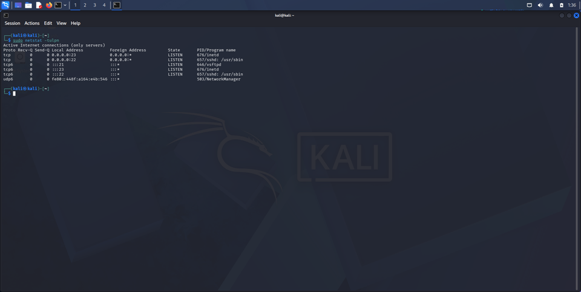
Netstat listening ports with name

Slide 3
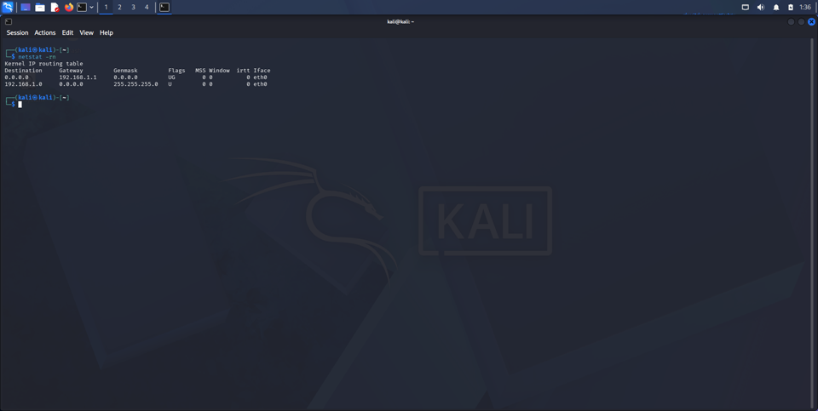
netstat –rn showing routing

Slide 4
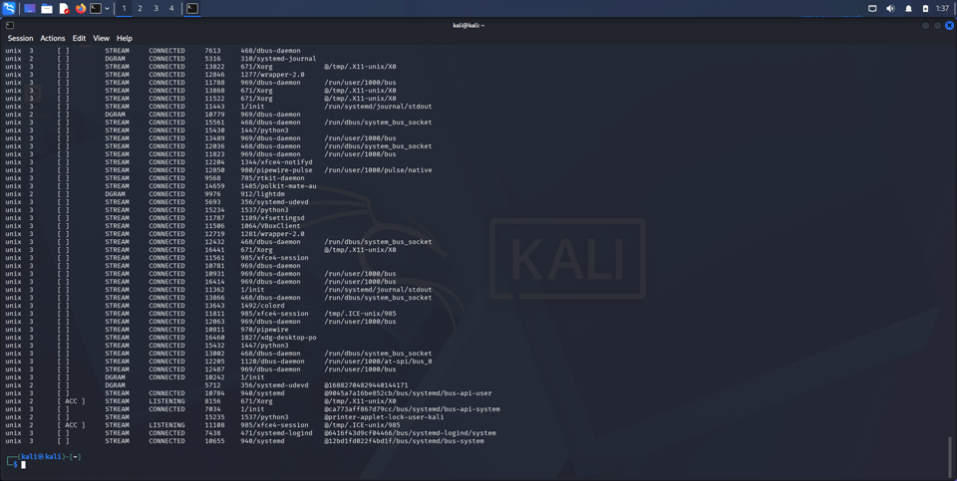
sudo netstat –anp
Showing connections with PIDs

Slide 5
FTP and Telnet connections were insecure

